Slide 1






PRESENTATION 2026
Content Alchemy- Ad-copy Genius
Student Name
Student Email
Sanchi Mittal
sanchiwork28@gmail.com
Mentor Name
Uma Maheshwari

Slide 2

Outline
Abstract of the Project
Problem Statement
Proposed Solution
System Architecture
Live Demo of the Project
Embedded Video of Project
Conclusion
Future Scope

Slide 3

Abstract
The bot is a Microsoft Copilot Studio-powered chatbot that automates marketing content generation for Amazon India sellers. Using the Amazon India 2025 Sales Dataset, the bot collects 9 structured inputs and instantly generates an Instagram caption, sentiment analysis, regional language adaptation, competitor positioning, and multi-platform copy — reducing manual content creation from hours to seconds.
Tools: Microsoft Copilot Studio · Power BI · Structured Prompt Engineering · Amazon India 2025 Dataset
Key Result: Structured prompts scored 4.6/5 vs 2.3/5 for generic prompts — a 100%+ improvement across 4 KPIs.

Slide 4

Problem Statement
1. Time-Intensive Manual Process Writing one Instagram ad caption manually takes 2–3 hours. Sellers with hundreds of products simply cannot do this at scale.
2. Generic, Unconvincing Copy Sellers write copy like "Buy our amazing product now!" — ignoring the most powerful asset they already have: real customer reviews.
3. Zero Localization India has 22+ regional languages. Sellers use the same English copy for customers in Maharashtra, Tamil Nadu, and West Bengal — losing hyperlocal relevance entirely.
4. No Intelligent Routing Sellers have no system to distinguish between a 5-star product ready for advertising and a 1-star returned product that should never be advertised — leading to wasted ad spend.

Slide 5
Proposed Solution
Microsoft Copilot Studio serves as the core engine — a 9-question chatbot that collects product name, category, state, price, rating, review, delivery status, competitor details, and platform choice.
Structured Prompt Engineering converts raw inputs into professional marketing copy — outperforming generic prompts by 100%+ across all 4 KPIs.
Intelligent Condition Logic routes the flow automatically:
Rating ≤ 2 or Returned → Seller Alert (block ads, suggest improvements)
Rating 3–5 + Delivered → Generate full content pack
5 Outputs in One Interaction: Instagram Caption · Sentiment Analysis · Regional Language Caption · Competitor Positioning · Multi-Platform Copy

Slide 6
System Architecture
Data Input / Source
Analysis
Amazon India 2025 Sales Dataset — 15,000 rows, 14 columns including Product Name, Category, State, Unit Price, Rating, Review Text, and Delivery Status.
Dataset was Preprocessed in Excel . Power BI was used to visualize review rating distribution across Indian states, top product categories, and delivery status patterns — directly informing the bot's prompt logic and condition routing.
AI/Tool Integration
Output
Core Engine: Used across 5 stages: Idea generation → Reference content gathering → Chatbot topic flow building → PowerFx condition formula support → Report writing and documentation.
Bot Workflow: Trigger → 9 Questions → Condition Check (Rating/Delivery) → AI Prompt Node → 5 Outputs delivered in one message.
Instagram caption with social proof and CTA · Sentiment breakdown (praised / concern / overall) · Regional language version auto-detected by state · Competitor positioning caption · WhatsApp status + Amazon description.

Slide 7
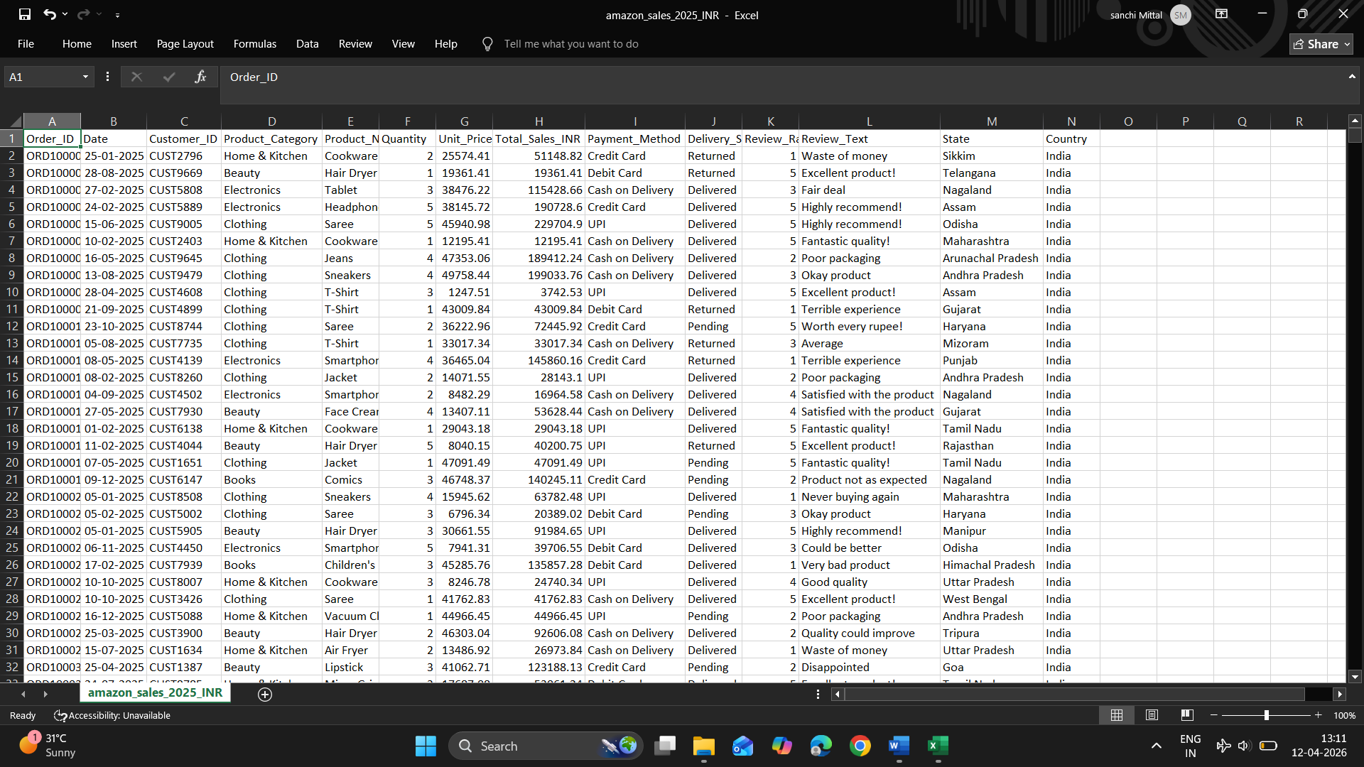
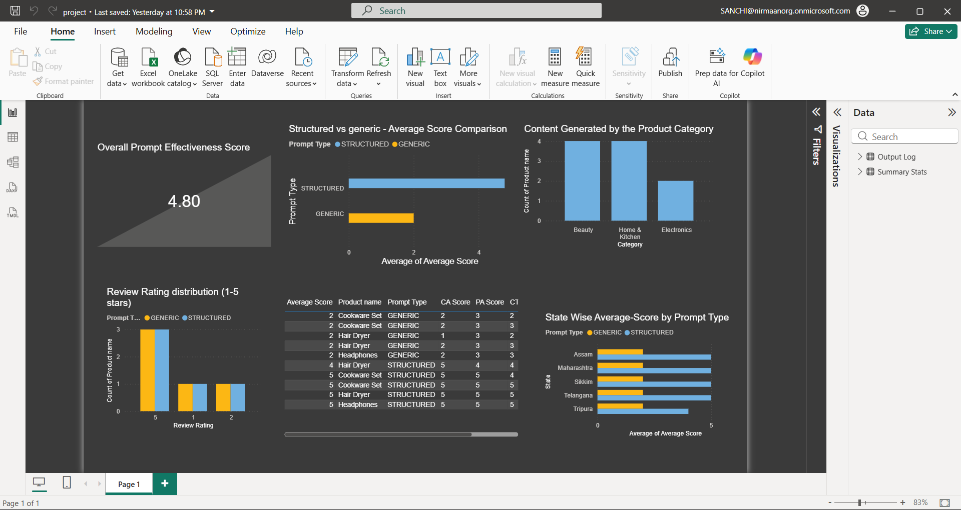
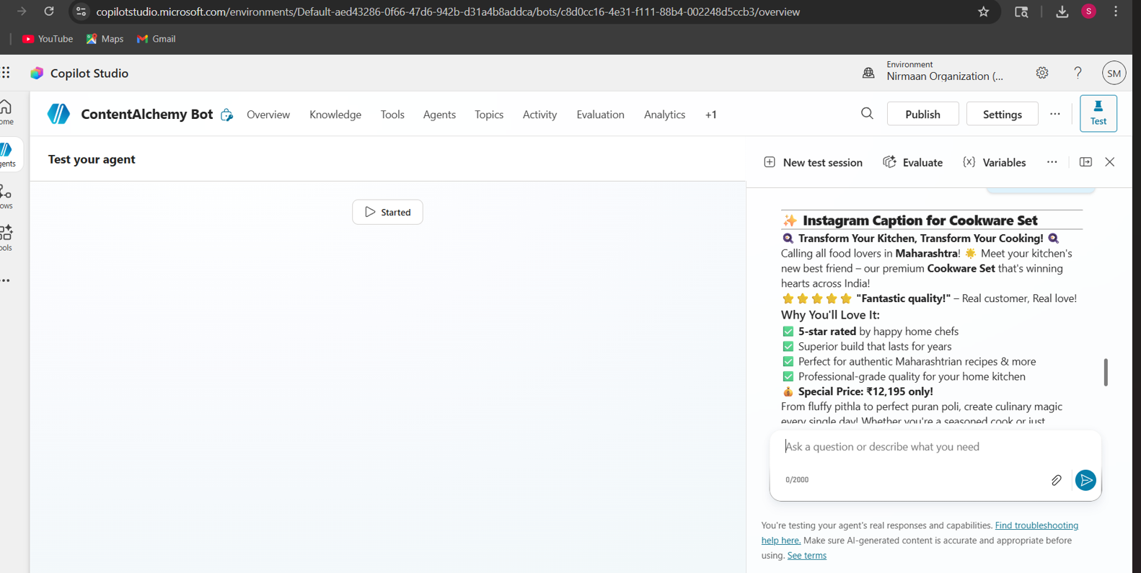
Live Demo of Project
Here's the list of some demo screenshots / features of the project:
Demo 1
Demo 2
Demo 3
[Add description of Demo 2 here — what this demo shows, key features, and results achieved.]
[Add description of Demo 3 here — what this demo shows, key features, and results achieved.]

Slide 8
Video of Project Demo
[https://your-project-demo-link.com]
▶
[Insert your project demo video.
You can embed a video your live project.]

Slide 9

Conclusion
AI-Driven AdCopy Genius successfully solved the real operational problem of generic, time-consuming marketing copy generation for Amazon India sellers — delivering a complete, data-driven, AI-powered solution in one guided workflow.
Key Findings:
Structured prompts dramatically outperform generic prompts across all 4 KPIs — Contextual Accuracy, Sentiment Alignment, CTA Strength, and Personalization
Personalization had the biggest score gap— proving regional data is the single most impactful variable in Indian e-commerce marketing
The Seller Alert system adds intelligent business judgment — not just content automation — to the seller's workflow
Microsoft Copilot Studio enabled a no-code, enterprise-grade chatbot accessible to any seller without technical expertise
CONCLUSION

Slide 10

Future Scope
1. Amazon Seller API Integration Pull product data automatically from the seller's Amazon account — eliminating all manual input and enabling bulk content generation for entire catalogues.
2. AI Image Prompt Generator Pair the caption with a DALL-E or Microsoft Designer prompt — producing both text and visual content from a single seller input.
3. Real-Time Sentiment Tracker (Power BI) Monitor how review sentiments shift over time and auto-suggest updated prompt templates when negative trends are detected.
4. WhatsApp Business API Integration Allow sellers to generate ad copy directly from WhatsApp — no desktop or technical knowledge needed.

Slide 11
Thank You
AICW Fellowship | Student Project Presentation 2026
LinkedIn | Edunet Foundation

